Slide 1

THE OUTSIDERS
PROJECT: COVID-19 IN THE UK

Slide 2
TEAM MEMBERS
Nnamdi Okoroji
Calum Knight
Mihai Flore
Adna
Kantai Melau

Slide 3

CONTENTS
Project Description
Research Questions
Data Sets
Countrywide comparison
Regional comparison
Heat maps
Hypothesis

Slide 4

PROJECT DESCRIPTION

Slide 5
UK COVID-19
The study examines the COVID-19 situation in the UK.
This is done to draw comparisons and to understand the patterns that exist in the data.
It also attempts to get a geographical representation of the COVID situation. The information provided would be relevant to the UK government for future planning.

Slide 6
Research Questions
What were the trends observed over the pandemic with regards to:
Deaths
Hospital admissions
Number of cases
What trends were observed for these at a regional level?
What effect did lockdown/vaccinations have on the above?
Creating a heatmap to show the effects of lockdown on covid across the UK
We will be testing 2 null hypotheses:
1. The booster vaccine has no effect on the number of deaths
2. The population of a location has no effect on the number of cases recorded.

Slide 7
DATA SETS
https://www.kaggle.com/code/vascodegama/uk-covid-19-cases-deaths-vaccines-regions
https://coronavirus.data.gov.uk/details/healthcare
https://developers.google.com/maps/

Slide 8

National Trends

Slide 9
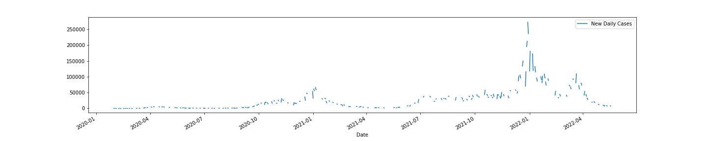
Daily Cases
1st Lockdown
2nd Lockdown
Vaccination starts

Slide 10
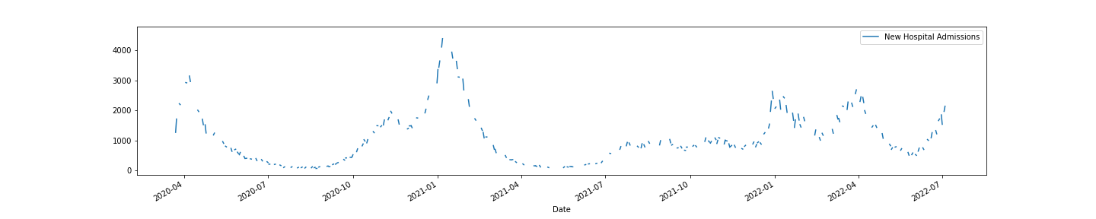
Daily Hospital Admissions
1st Lockdown
2nd Lockdown
Vaccination starts & Lockdown

Slide 11
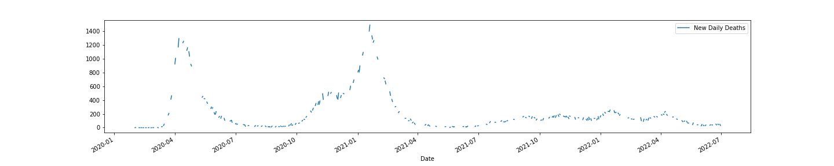
Daily Deaths
1st Lockdown
2nd Lockdown
Vaccination starts & Lockdown

Slide 12
Regional Trends

Slide 13
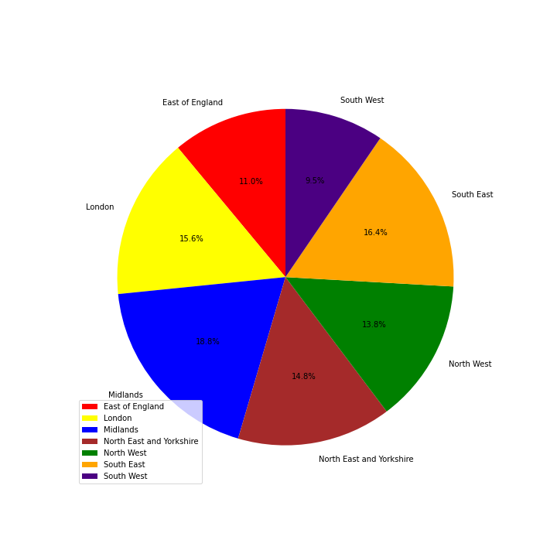
REGIONAL COMPARISON

Slide 14
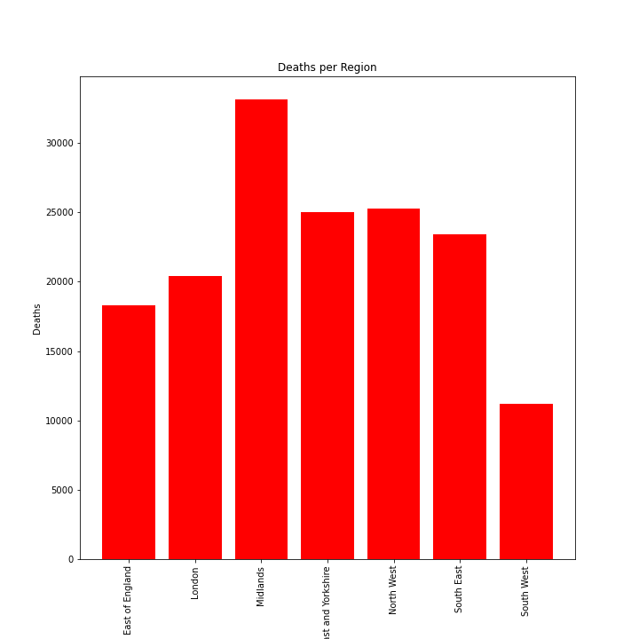
Deaths per Region

Slide 15
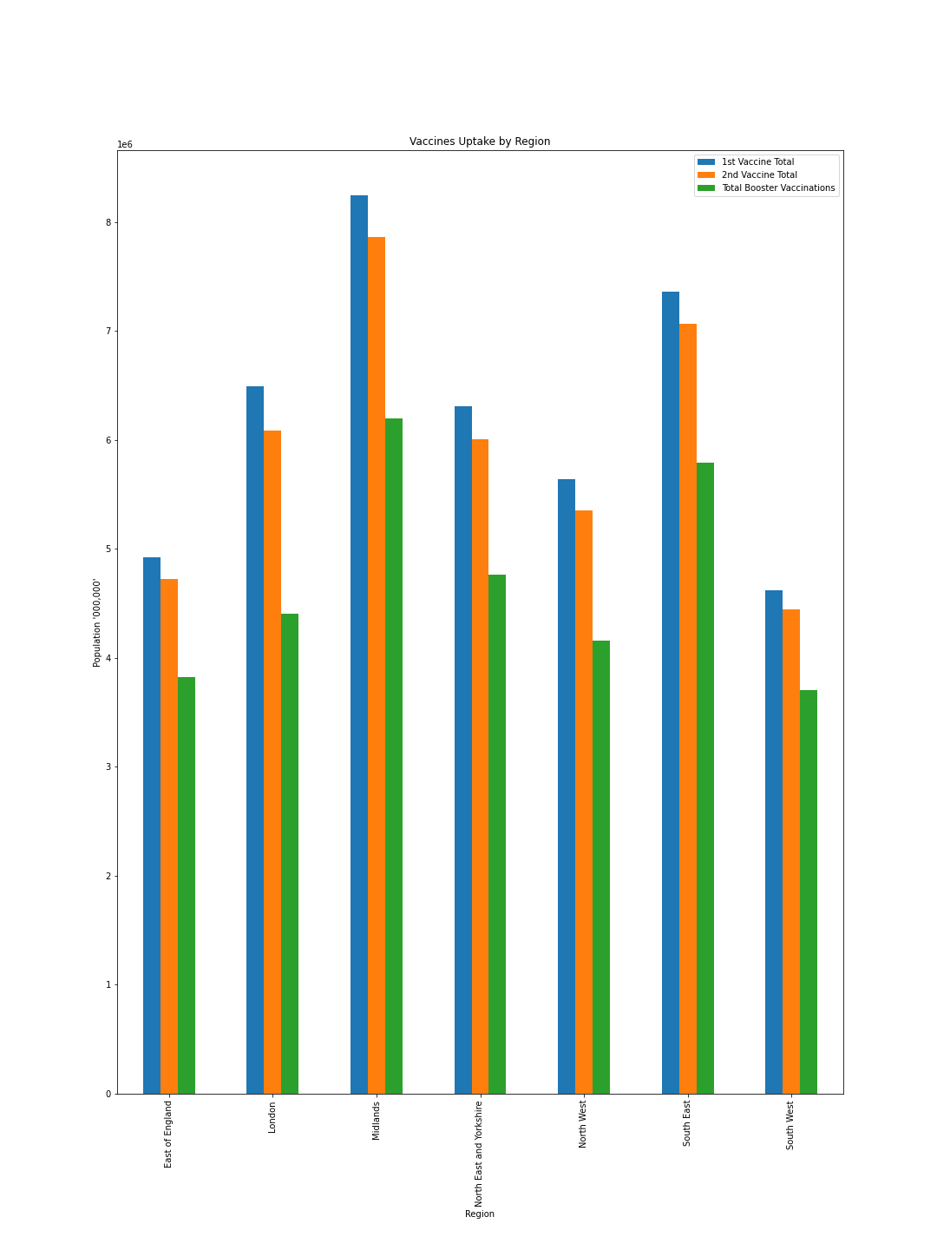
Vaccines Given Per Region

Slide 16
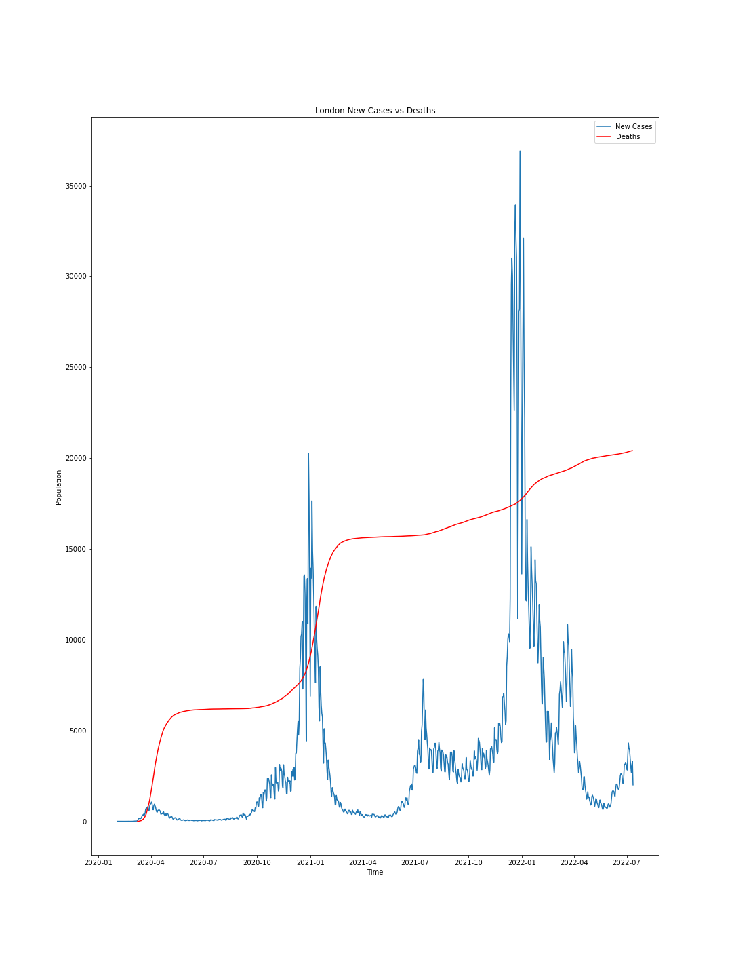
London New Cases

Slide 17
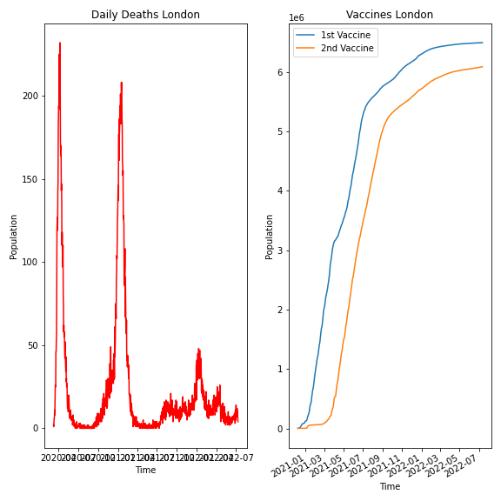
London Deaths Vs Vaccines

Slide 18

Heatmaps

Slide 19
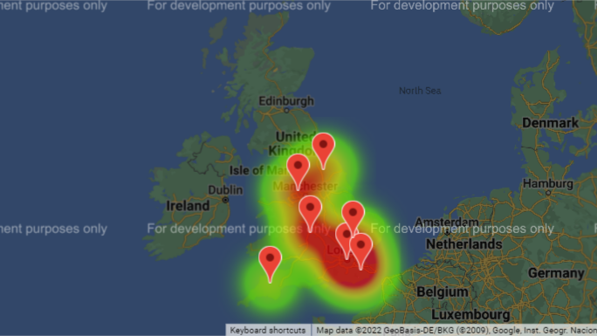
Pre-Lock down Heatmap

Slide 20
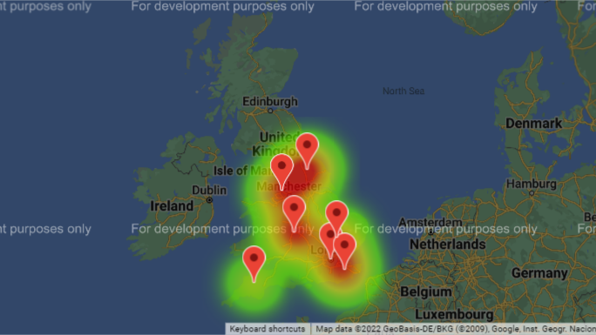
Post-Lockdown Heatmap

Slide 21

Hypothesis

Slide 22
Hypothesis 1
Null Hypothesis
The booster vaccine has no effect on the number of deaths
Alternative hypothesis
The booster vaccine causes a reduction on the number of deaths.
T-Test, the pvalue = 1.3424073380898807e-05
Pvalue< 0.05
Reject the Null Hypothesis

Slide 23
Hypothesis 2
Null Hypothesis
The population of a location has no effect on the number of cases recorded.
Alternative Hypothesis
The higher the population of a location the more the cases recorded.
T-Test, the pvalue = 2.1904276395075232e-05
Pvalue< 0.05
Reject the Null hypothesis.

Slide 24
THANK YOU!

